Slide 1

Research Progress Record
Enmao Diao
June 20 2021

Slide 2
Overview
GAL: Gradient Assisted Learning
SemiFL: Semi-Supervised Federated Learning
Semi-Supervised Federated Learning for Keyword Spotting
Compressing Turbulence
Decentralized Multi-Domain Recommender Systems
Mega Learning
Sparsity Index
Finite Neural Networks
Others

Slide 3
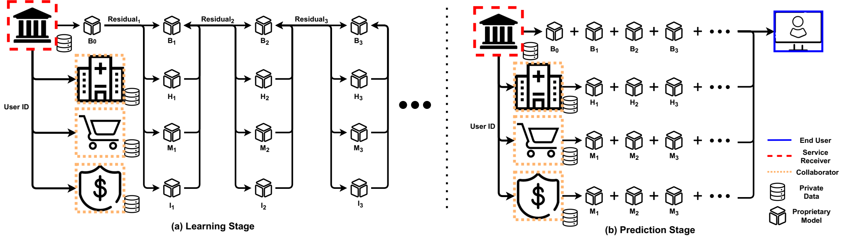
GAL: Gradient Assisted Learning
Submitted to NeuraIPS 2022
We propose Gradient Assisted Learning (GAL), a new method for various entities to assist each other in supervised learning tasks without sharing data, models, and objective functions.

Slide 4
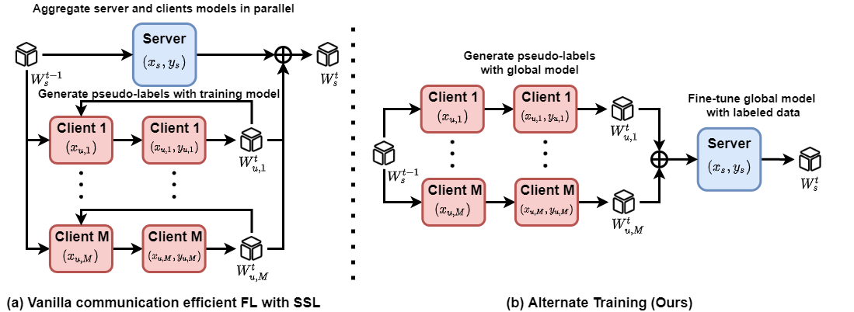
SemiFL: Semi-Supervised Federated Learning
Submitted to NeuraIPS 2022
We propose a new Federated Learning framework referred to as SemiFL in order to address the problem of Semi-Supervised Federated Learning (SSFL).

Slide 5
Semi-Supervised Federated Learning for Keyword Spotting
Prepared for ICASSP 2023
Previously rejected by InterSpeech 2022
Need more novelty
Mixup background and unknown keyword
Threshold for binary opposite keyword
Amazon internal wakeword dataset
Fine tune at server to mitigate Non-IID issue

Slide 6
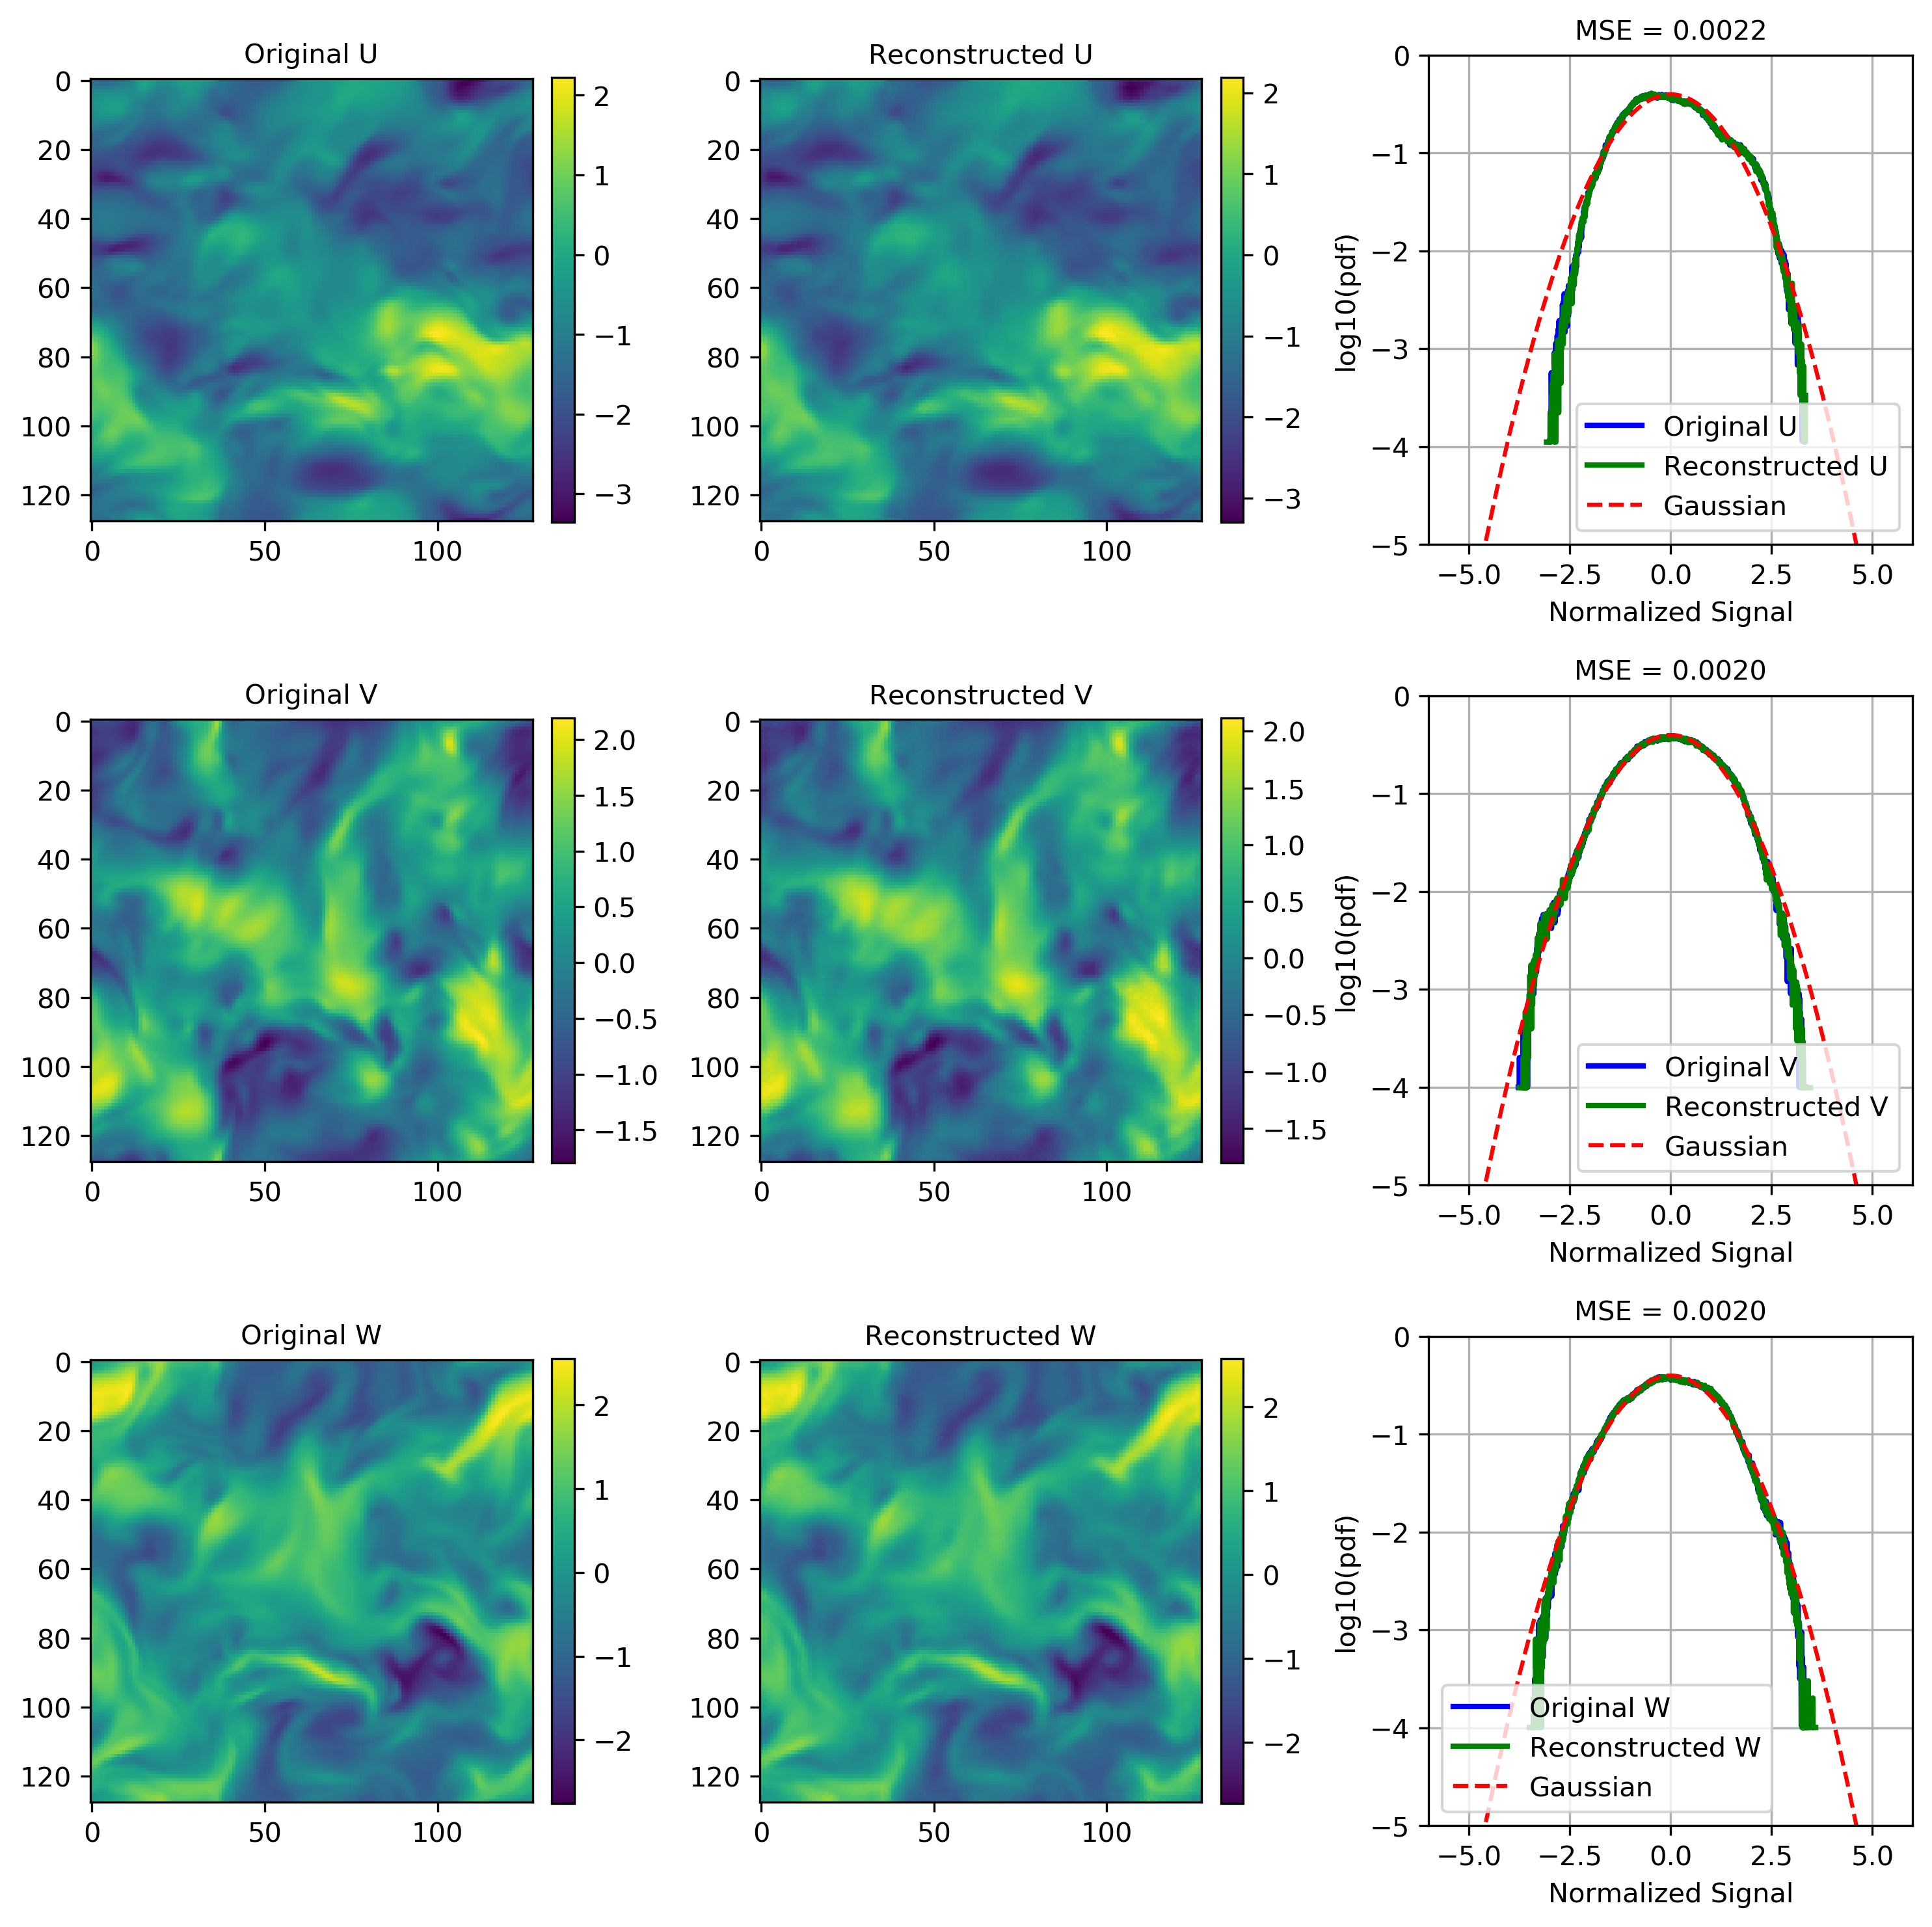
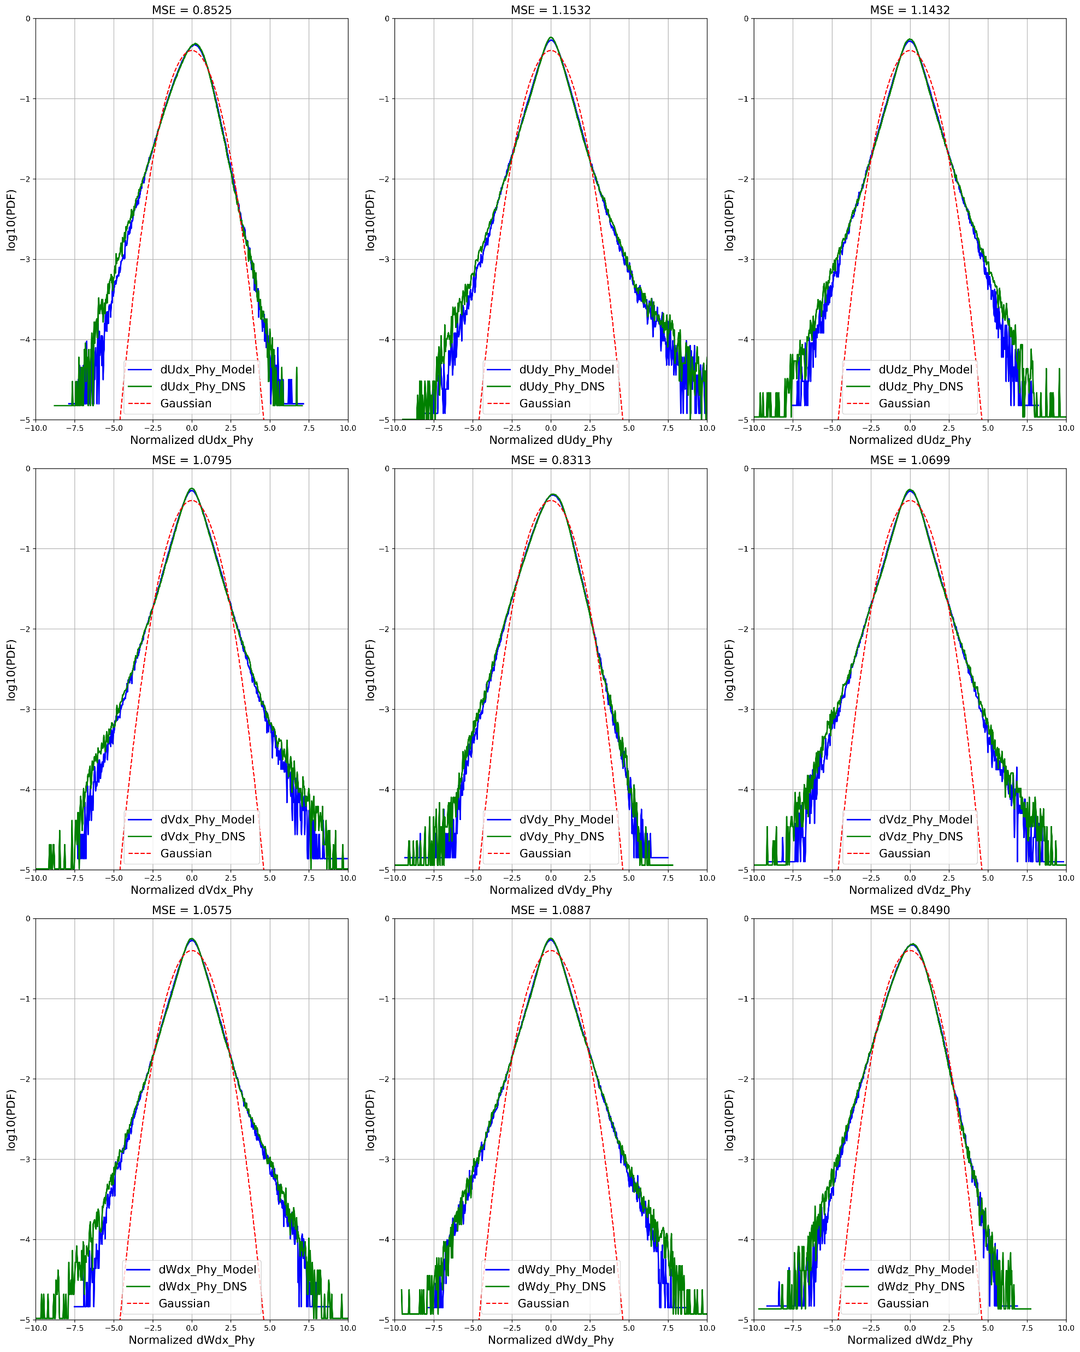
Compressing Turbulence
Accepted by Journal of Turbulence
DCC 2022 (accepted main paper)
AAAI-MLPS2 2022 (accepted poster)

Slide 7
Decentralized Multi-Domain Recommender Systems
Prepared for WDSM 2023
Multiple organization collaboratively learn a recommendation system
User/Item align
Explicit/Implicit feedback
AutoEncoder
Use gradient assisted learning to train vertical-split recommendation data
Cold-start problem
ML100K, ML1M, ML10M, Amazon, Douban datasets
RMSE and NDCG

Slide 8
Mega Learning
With Jiawei Zhang
Prepare for AAAI 2023, ICLR 2023
Combine multiple heterogenous pre-trained classifier
Round Robin Non-IID data partition
Predetect classifier and then ensemble distillation

Slide 9
Sparsity Index
With Guanghua Wang
Prepare for AAAI 2023, ICLR 2023
Sparsity Index for compressing using a lottery ticket framework
Benefit
Hungry initial compression
Early stopping
Radom init with carefully scaled parameters
Train to maximize SI as regularizer

Slide 10
BoostFL: Personalized Federated Learning with Boosting
Prepared for ICASSP 2023
Cohort-level personalization
Boosting to flexible incorporating into existing federated learning frameworks

Slide 11
Finite Neural Networks
Input, weights and output are all on finite field
I find formal derivatives can be defined for finite field with product rule of calculus
In mathematics, the formal derivative is an operation on elements of a polynomial ring or a ring of formal power series that mimics the form of the derivative from calculus.
https://en.wikipedia.org/wiki/Formal_derivative
For example d(X^5)/dx = 5X^4 which means summation of X^4 5 times. d(f(X)/5)/dx = 1/5 d(f(X))/dx in finite field means find a value that when add 5 times equal d(f(X))/dx.
I think it is feasible to implement Finite Neural Networks with these definition.

Slide 12
Others
Hscore (Suya Wu)
Fly dataset
Change point detection
Dynamic FL (Qi Le)
Clients with different number of updates for each communication round
Mitigate Non-IID issue
Prepare for ICLR 2023
Federated Autoencoders for Personalized Federated Recommender Systems (Qi Le)
Personalized Autoencoders with independent encoder
Prepare for Asilomar 2022

Slide 13
Others
Federated Client Selection against data poisoning with validation data (Xianjian Xie)
With gradient of validation dataset at server to detect poisoned clients
Prepare for IEEE Bigdata 2023
Federated Unsupervised Domain Adaptation for Target Clients
Target (unlabeled data) at clients, and Source (labeled data) at server
Assisted Learning on Time Series forecasting
Assisted Supply Chain Forecasting, Earthquake prediction, Financial Trading
Match with timestamp and geographical location (universal ID) for supply chain forecasting
Noisy alignment
Distributed Feature Selection for Assisted Learning

Slide 14
Others
Fairness
Fair Federated Learning (Greg Fields, Amazon Intern)
Fair Assisted Learning for medical data (Yuzhe Gu)
Divergence of sample gradient
Saddle point
Small residual for small learning rate
Backpack library
Subnetwork FL (Kamala Varma, Amazon Intern)
Once-for-all FL
Pruning
Sample heterogeneous FL (Isidoros Tzitotis, Amazon Intern)

Slide 15
Others
Personalized FL with embedding (Liam Collins, Amazon Intern)
Deep Audio Signal Coding (Emily Shao, Yuzhe Gu)
Compress SDCT, STFT (mag and phase separately)
Transformer
Hierarchical residual based Vqvae
Deep Speech Emotion Recognition (Gaoxiang Luo)
Wavelet based feature extraction
Neural Wavelet
Deep Audio Style Transfer

Slide 16
Others
Semi-Supervised Learning with mask (Ali Rajabi, UMN PhD)
Federated Reinforcement Learning
Weakly Supervised Learning
Lifelong Learning
Online Domain Adaptation
Online Federated Learning
Lifelong federated generative model
Lifelong learning with recalibration of BN

Slide 17
Others
Predictive gradient descent, meta-learning
Forget about learning rate. Theoretically there always exists a best gradient step at each iteration. We use learning history as our training data and predict the best gradient step. Deep Learning for optimization
Reinforcement learning to choose learning rate for faster convergence
Generator for model parameters to get fast warm-up
Recommender Systems with Autoencoder
Deep Communication
Channel Coding
MIMO
Frequency domain or wavelet-based channel coding with Fourier operator

Slide 18
Others
Defend adversarial attacks from intermediate layers
Hypothesis: Even though we only change very little to the input image and easily attack trained neural network. Intermediate layer features should have a very different distribution from the trained dataset. The change of result cannot happen within one layer. It is the deep nature makes classifier fragile
Design a simple Defensive BatchNorm to check statistics for adversarial detection
Recent works use MMD as data to learn detect adversarial attack
Boosting GAN
Inspired by Progressive GAN
Each scale is a network and the next network is trained from pseudo-residual
Transformer

Slide 19
Others
Efficient multi-task learning with random mask
Randomly and train mask
Graph Neural Network
Fuse pretrained neural network
Fuse at certain layer with regularization
Genetic optimization of mask
Symbolic Neural Network
Prune
Finetune
Genetic optimization of symbolic choice

